Slide 1

Automated Unity Catalog Provisioning
via Azure DevOps Pipeline
Azure Databricks
Demo Presentation
Unity Catalog
Jinja2 Templates
Databricks CLI
SQL Automation

Slide 2
Problem & Solution
❌ The Problem
✅ Our Solution
Manual catalog, schema & table creation in Databricks UI
Error-prone — no version control or audit trail
Inconsistent naming across environments (dev/prod)
No repeatable process for onboarding new projects
Grant management scattered and undocumented
Azure DevOps pipeline with YAML automation
Jinja2 templates for all UC objects (catalog → grants)
Single params.json per project — one source of truth
Databricks SQL Statements API for reliable execution
Git-tracked, repeatable, environment-agnostic
→

Slide 3




Pipeline Architecture
1. Trigger
▶
2. Generate SQL
▶
3. Execute SQL
▶
4. UC Objects Ready
Push to main branch in Azure DevOps Git repo
generate_sql.py renders Jinja2 templates with params.json
Databricks SQL Statements API runs files in order
Catalog, schemas, tables & grants created/updated
Files execute in sorted order: 01_catalog → 02_schemas → 03_external_locations → 04_volumes → 05_tables → 06_grants

Slide 4




Repo Structure & Key Files
📁 Repo Layout
deploy-uc.yaml
adb/
├─ pipeline/
│ └─ deploy-uc.yaml
├─ template/
│ ├─ 01_catalog.sql
│ ├─ 02_schemas.sql
│ ├─ 03_external_locations.sql
│ ├─ 04_volumes.sql
│ ├─ 05_tables.sql
│ └─ 06_grants.sql
├─ projects/
│ └─ ProjectCTD/
│ └─ params.json
└─ generate_sql.py
Azure DevOps pipeline — installs CLI, runs generator, executes SQL via Databricks API
template/*.sql
Jinja2 SQL templates for each UC object type. Parameterized — never hardcode values here
generate_sql.py
Renders templates → rendered SQL files written to projects/<PROJECT>/
params.json
One file per project: catalog name, schemas, tables, external locations, volumes, grant groups

Slide 5
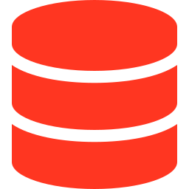





Unity Catalog Objects Provisioned
Catalog
CREATE CATALOG IF NOT EXISTS ...
Schemas
External Locations
CREATE SCHEMA IF NOT EXISTS ...
CREATE EXTERNAL LOCATION IF NOT EXISTS ...
Volumes
Tables (Delta)
CREATE VOLUME IF NOT EXISTS ...
CREATE TABLE IF NOT EXISTS ... USING DELTA
Grants
GRANT USE CATALOG / USE SCHEMA / SELECT ...

Slide 6

Single Source of Truth — params.json
{
"catalog_name": "projectCTD_dev",
"schemas": [
{ "name": "raw", "comment": "..." },
{ "name": "curated", "comment": "..." }
],
"external_locations": [
{ "name": "ext_loc_raw",
"url": "abfss://raw@<acct>...",
"credential_name": "proj_cred" }
],
"volumes": [
{ "schema": "raw", "name": "landing",
"type": "EXTERNAL",
"path": "abfss://raw@<acct>..." }
],
"tables": [ { "schema":"raw",
"name":"customers", "columns":[...] } ],
"groups": {
"data_engineering": "team@org.com",
"data_science": "ds@org.com" }
}
catalog_name
Target Unity Catalog. Drive dev/prod by changing this one value.
schemas
List of schemas to create. Tables reference these by name.
external_locations
ADLS Gen2 paths + storage credential. Empty list = skipped.
groups
Grant targets. Use AAD group email or individual service principals.

Slide 7





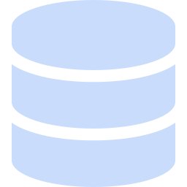
Key Benefits
Repeatable
Version Controlled
Secure
Run the pipeline on any project just by adding a params.json. No UI clicks required.
Every schema, table, and grant definition lives in Git. Full audit trail via PR history.
Secrets (HOST, TOKEN, WAREHOUSE_ID) stored in Azure DevOps Library — never in code.
Idempotent
Extensible
UC Best Practices
All SQL uses IF NOT EXISTS. Safe to re-run; won't break existing objects.
Add a new project by creating a new projects/<NAME>/params.json and updating PROJECT var.
USING DELTA, USE CATALOG/SCHEMA grants, three-part naming throughout.

Slide 8
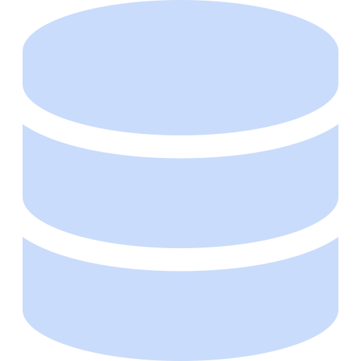
Jinja2 + Python vs Databricks Asset Bundle (DAB)
FACTOR
✔ Jinja2 + Python (Our Approach)
Databricks Asset Bundle (DAB)
Learning Curve
✔ Low — plain Python & SQL
✖ Medium-High — new DAB YAML schema
UC Object Support
✔ Full — catalog, schemas, tables, volumes, grants
✖ Partial — UC objects still maturing in DAB
Portability
✔ Pure SQL — runs on any SQL endpoint
✖ Databricks-specific — tied to DAB CLI
Debuggability
✔ Read generated .sql files directly
✖ bundle validate — less transparent
Idempotent
✔ IF NOT EXISTS on every statement
✖ Depends on object type; less consistent
Azure DevOps Fit
✔ Simple bash + REST API — no extra tooling
✖ DAB CLI required on every build agent
Best For
✔ UC object provisioning (this pipeline)
Jobs, DLT pipelines, notebooks, clusters
💡 Verdict
Use Jinja2 for UC object provisioning (this pipeline). Use DAB for jobs, DLT pipelines & notebooks. Both tools are complementary.

